Slide 1
Unmet Research Need: Sickle Cell Disease Pain as a Whole Person Health Challenge
2025 International Congress on Integrative Medicine and Health, March 7, 2025
Inna Belfer M.D., Ph.D. , Deputy Branch Chief
Basic and Mechanistic Research Branch
National Center for Complementary and Integrative Health
National Institutes of Health
Notes:
Good morning/afternoon. Thank you for the opportunity to present NCCIH’s priorities in supporting SCD Research. I am Inna Belfer, Deputy Branch Chief of Basic and Mechanistic Research Branch at the Division of Extramural Research of National Center for Complementary and Integrative Health (NCCIH) and one of NIH Pain Consortium Representatives.

Slide 2
Disclaimers
I don’t have any conflicts of interests.
This presentation does not represent NCCIH or NIH perspectives.

Slide 3
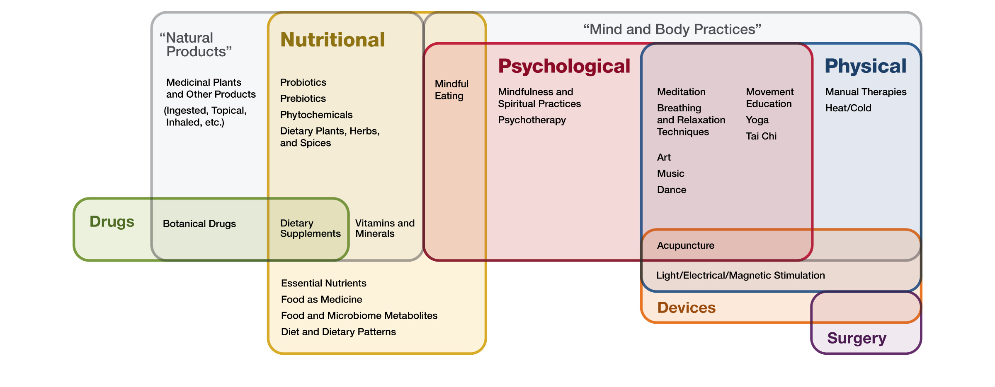
What are complementary and integrative health approaches?
Pitcher MH, Edwards E, Langevin HM, Rusch HL, Shurtleff D. Complementary and integrative health therapies in whole person resilience research. Stress Health. 2023 Sep;39(S1):55-61. doi: 10.1002/smi.3276. Epub 2023 May 27. PMID: 37243503
Notes:
This graphic shows the primary therapeutic input of approaches that may be studied within the NCCIH portfolio.

Slide 4
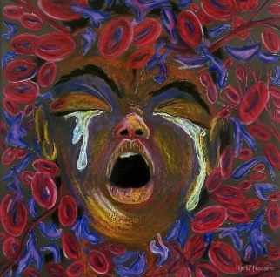
SCD pain
PAIN
is the most
common
clinical complication of SCD
A. Aich, M.K. Jones, K. Gupta Pain and sickle cell disease. Curr Opin Hematol, 26 (3) (2019), pp. 131-138
§
Severe acute
pain episodes,
chronic
persistent pain, &
neuropathic
pain
§
“Ten Refined” by Hertz Nazaire
§
Even after
curative therapy
, severe chronic
pain continues
in
40%
of individuals
N.A. Al Hamayel, J.M. Waldfogel, S.M. Hannum, et al. Pain experiences of adults with sickle cell disease and hematopoietic stem cell transplantation: a qualitative study Pain Med, 22 (8) (2021), pp. 1753-1759
Significant impact
of SCD
pain
§
High rates of hospitalizations/ER visits, missed school/work, poor functional &
psychosocial outcomes, & increased rate of mortality
D. Sharma, A.M. Brandow Neuropathic pain in individuals with sickle cell disease Neurosci Lett, 714 (2020).
Complex
pain
management
§
Often doesn’t address comorbidities (e.g., anxiety, stress,
sleep disturbance, SCD complications)
National Academies of Sciences, Engineering, and Medicine. Addressing sickle cell disease: a strategic plan and blueprint for action. Published September 10, 2020. Accessed March 29, 2024.
Notes:
Sickle cell disease (SCD) is a lifelong monogenic, autosomal-recessive blood disease that predominantly affects individuals of African descent

Slide 5
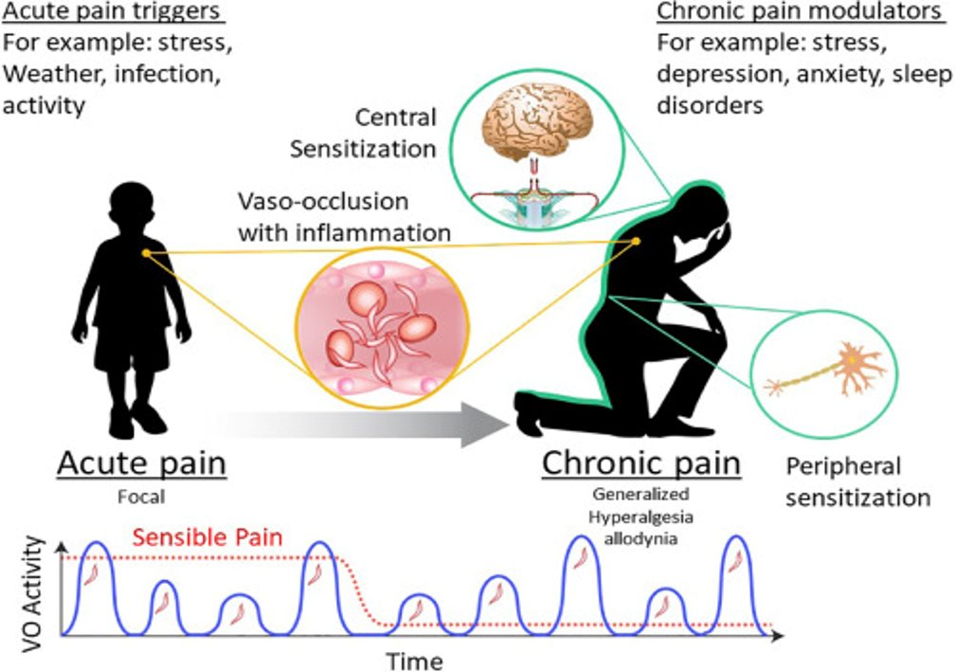
Limited Research on SCD Pain
Ischemic, inflammatory, and neuropathic components
Transition from acute to chronic form
Across the lifespan
Factors influencing SCD pain perception
P. Niscola, F. Sorrentino, L. Scaramucci, P. de Fabritiis, P. Cianciulli
Pain syndromes in sickle cell disease: an update. Pain Med, 10 (3) (2009), pp. 470-480
A.M. Brandow, K.J. Zappia, C.L. Stucky Sickle cell disease: a natural model of acute and chronic pain Pain, 158 (Suppl 1) (2017), pp. S79-S84
B. Nicholson Differential diagnosis: nociceptive and neuropathic pain
Am J Manag Care, 12 (9 Suppl) (2006), pp. S256-262
https://www.jpain.org/article/S1526-5900(18)31017-4/fulltext
Pain Trajectory:
Acute to chronic; Acute on chronic
Notes:
we know much about SCD as a genetic disease, with well-known genetic mutations causing various levels of red blood cells sickling, and established understanding of underlying pathophysiology. However, we do not have this extend of knowledge about SCD pain mechanisms of which are still poorly understood. There is enormous heterogeneity in SCD pain population, as well as within-individual variability. In addition, pain trajectory in SCD is unique and complicated. It always starts with acute pain episode, and the type of pain may change across lifespan. Pediatric pain is characterized by multiple vaso-occlusive pain crises. Most patients develop chronic pain, with sudden acute pain episodes and vaso-occlusive crises occurring on top of chronic persistent pain.

Slide 6
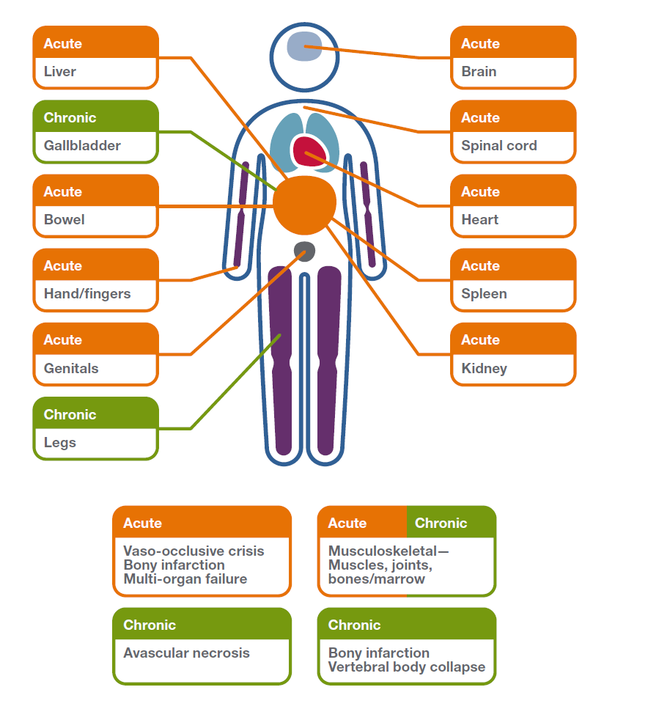
A Multi-Organ Clinical Problem
Figure from Belfer I, Chen W, Weber W, Edwards E, Langevin HM. Unmet Need: Mechanistic and Translational Studies of Sickle Cell Disease Pain as a Whole-Person Health Challenge. J Pain. 2024 Oct;25(10):104603.
G.J. Kato, F.B. Piel, C.D. Reid, et al. Sickle cell disease. Nat Rev Dis Primers, 4 (2018)
M.A. Bender, K. Carlberg Sickle cell disease M.P. Adam, G.M. Mirzaa, R.A. Pagon, et al. (Eds.), GeneReviews® [Internet], University of Washington (2003), pp. 1993-2023
I. Osunkwo, B. Andemariam, C.P. Minniti, et al. Impact of sickle cell disease on patients’ daily lives, symptoms reported, and disease management strategies: results from the international Sickle Cell World Assessment Survey (SWAY) Am J Hematol, 96 (4) (2021), pp. 404-417
M.A. Bender, K. Carlberg Sickle cell disease M.P. Adam, G.M. Mirzaa, R.A. Pagon, et al. (Eds.), GeneReviews® [Internet], University of Washington (2003), pp. 1993-2023
Notes:
On clinical level – SCD pain, both acute and chronic is multi-organ problem. Due to organ damage caused by SCD, many patients report acute pain in their liver, spleen, kidney, intestine , chest, hands and genitals. Also, they may have severe headaches and central pain due to the strokes. Acute pain episodes are caused by VOC, bone infractions and multi-organ failure. Chronic pain often happens in gallbladder and legs resulting from avascular necrosis and bony infractions. Recently, several studies pointed musculoskeletal pain in patients with SCD. This pain is believed to reflect acute and chronic injuries to muscles, joints and bones.

Slide 7

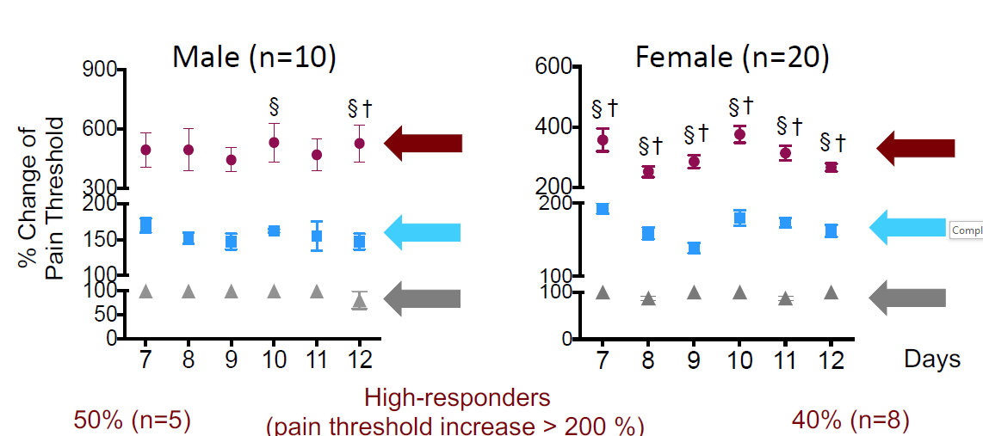
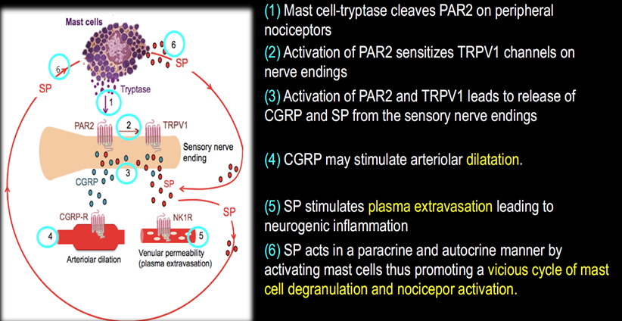
Most Animal Studies of SCD Pain Focus on Skin, Not an Organ Impacted in SCD Patients
Mast cell activation leads to pain
Sensitization of sensory nerve fibers (neuropathic pain)
Variable response to electroacupuncture
Vincent et al, Blood. 2013
Kenyon et al, 2015
Wang et al., 2016
SKIN
SKIN
SPINAL CORD, SKIN
Notes:
One of the biggest problems is that preclinical studies of organ damage in SCD do not measure pain. MOST ANIMAL STUDIES OF SCD PAIN FOCUS ON SKIN, NOT AN ORGAN IMPACTED IN SCD PATIENTS . For example, studies on mast cell activation causing SCD pain were done in rodents using skin preps. Studies focusing on sensitization of sensory nerve fibers were done in skin of sickle mice. Interventions study of the sickle mice response to electroacupuncture were also done in skin.

Slide 8
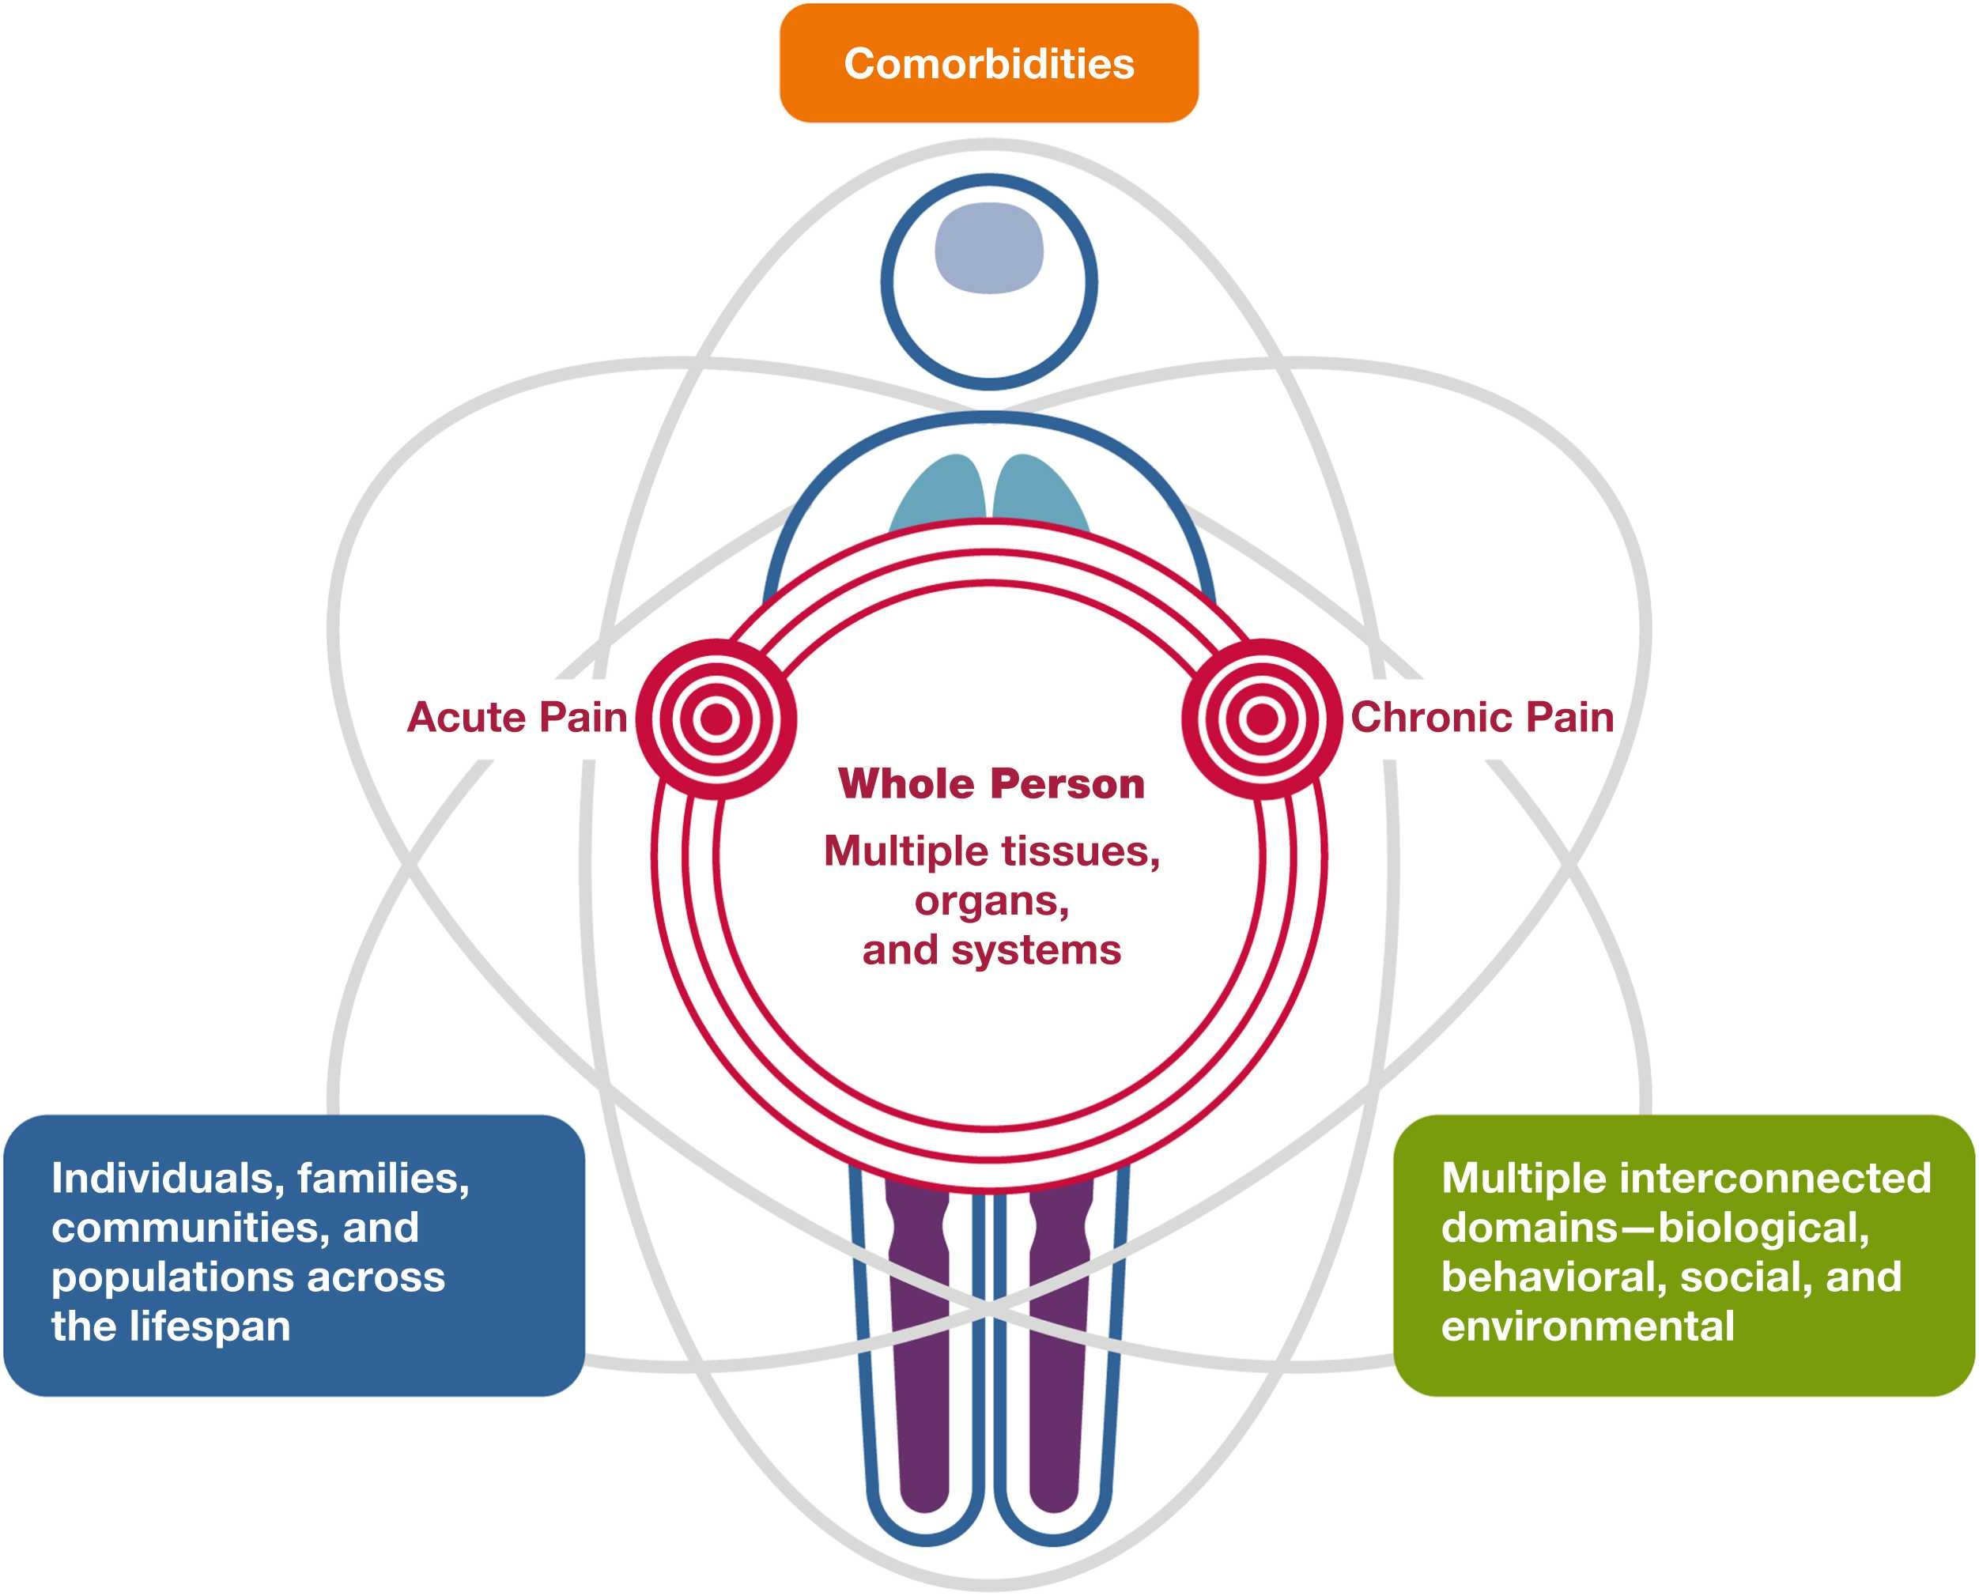
Figure from Belfer I, Chen W, Weber W, Edwards E, Langevin HM. Unmet Need: Mechanistic and Translational Studies of Sickle Cell Disease Pain as a Whole-Person Health Challenge. J Pain. 2024 Oct;25(10):104603.
Notes:
Another problem is limited understanding that pain in individuals with SCD is a complex problem that affects multiple tissues, organs, and systems and is influenced by multiple biopsychosocial factors, operating at a variety of levels..

Slide 9




Unmet Need
SCD Pain as Whole Person Health Challenge
Framework
Develop framework to enable translational and reverse translational studies
Interventions
Non-addictive pharmacological therapies
Complementary interventions
Integrative health interventions
Whole-person interventions
Technology
Humanized animal model
Muscle, bone, joint, visceral models
Mechanism-based pain phenotyping
Human tissues (DRGs, iPSC cells)
Omics, microbiome, neuroimaging
Longitudinal designs
People/Expertise
Hematologists, organ biologists, pain experts, physiologists, neuroscientists, psychologists, geneticists, microbiologists, immunologists, behavioral scientists, clinicians
Belfer I, Chen W, Weber W, Edwards E, Langevin HM. Unmet Need: Mechanistic and Translational Studies of Sickle Cell Disease Pain as a Whole-Person Health Challenge. J Pain. 2024 Oct;25(10):104603.
Notes:
Treating SCD pain as a Whole Person Health Challenge may lead to optimization of current treatment strategies and the development of novel therapies for SCD pain.

Slide 10
Collaborators:
Dr. Wen Chen
Dr. Wendy Weber
Dr. Emmeline Edwards
Dr. Helene M Langevin
Contact: 301-435-1573
inna.belfer@nih.gov

